Slide 1

Dreptul la Incalzire
Dragostin Catalin

Slide 2
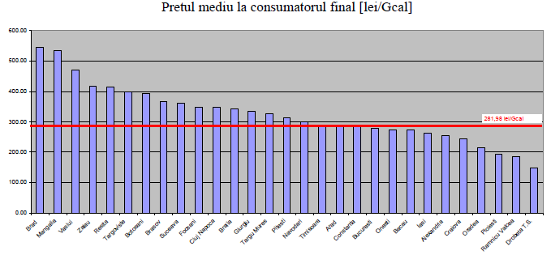
CALDURA : UNDE SUNTEM ASTAZI ?
SITUATIA INCALZIRII CENTRALIZATE DIN ROMANIA
Sursa: COGEN-Romania, 2010
DE CE SA REGLEMENTEZE O INVESTITIE CARE REDUCE COSTURILE ? EPC >20%

Slide 3
UNDE SUNTEM ?
POTENTIALUL RES IN ROMANIA
Sursa: Icemenerg, NRAP
(mii TEP)

Slide 4
CE AM REALIZAT DIN RES ?!

Slide 5
CALDURA: UNDE SUNTEM ASTAZI ?
Deja se foloseste “dezordonat” ~40% incalzire pe lemne ! (potential COGEN )

Slide 6

DATE STATISTICE INS CONSUM LEMN DE FOC (Preponderent Biomasa Forestiera)
INCALZIRE
3,5 mil.locuinte
~9,5 mil.tone “ilegal”
~10 mil.tone “legal”

Slide 7
INTERPRETAREA ENERGETICA
A DATELOR INS DPDV “STRATEGIC”
19,5 mil.tone/an biomasa = ~66,3 mil.MWh/an
La o durata minim economica de 5000 h/an functionare, potentialul energetic de micro/medie-cogenerare distribuita pentru incalzire ar fi :
  ~13.000 MW, din care :
    ~10,000 MWh putere termica utila transformabila in caldura si electricitate astfel:
      ~2500 MWe
      ~7500 MWt
Consideram numai ~30% potential tehnic si economic realizabil
  ~800 MWe (1 grup nuclear de la CNE Cernavoda !);
  ~2300 MWt, capacitate de incalzire a majoritatii oraselor mari/medii din Romania

Slide 8
Quote from: www.res4less.eu
Romania are un SURPLUS (!) de potential productie numai de electricitate din biomasa de 6,4 TWh/an (~1 grup nuclear ca Cernavoda !)
  Surplus de “potential ESRE”: ce ramine dupa indeplinirea obligatiei ESRE a statului respectiv
  Exista SM interesate sa investeasca in acest potential, in contul obligatiei proprii
Riscuri identificate:
  Acceptarea politica;
  Accesul la resurse (biomasa)

Slide 9
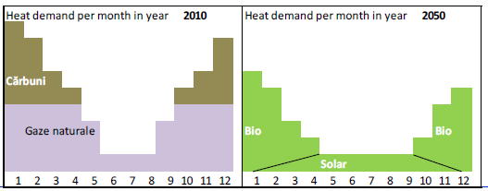
SPRE CE TREBUIE SA NE INDREPTAM ?
(Dir. 27/2012)

Slide 10
?
Nimeni nu pomeneste, nici macar CE, despre incalzirea “din nimic” (adica Vint !)
if we need heat, should we always burn something !?
Avem in Romania ~4000 MW despre care ne vaitam ca “cer certificate verzi” si, cind bate vintul, e “prea multa energie”

Slide 11
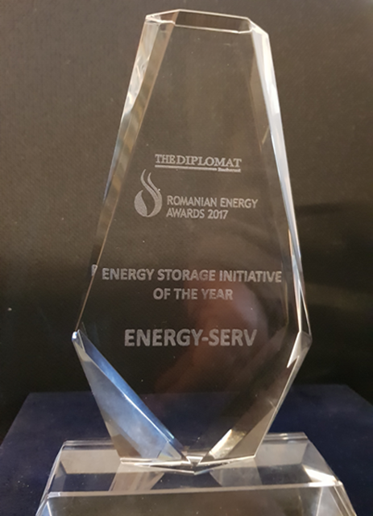


CHP “BATTERY”
-warm up with cold wind-
(if we need heat, should we always burn something !?)
Presented at: “2nd German‐Japanese Workshop on Renewable Energies”
5‐7 July 2017, Stuttgart, Germany
Patent application, Legal Assistance: Law firm Ciurtin & Associates
Dragostin Catalin – Director, SC ENERGY SERV SRL
- President, ESCOROM

Slide 12
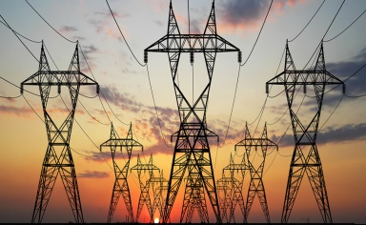



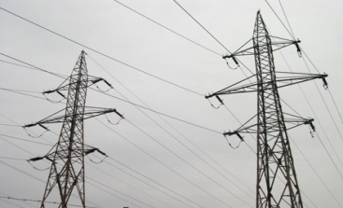

Possible Configuration Arrangements
(to meet the GC- Green Certificates- regulations)
OPTION 1
2 GC
Heat Pipe<10 Km
OPTION 2
2 GC
2 GC
Dedicated Transp. Line>10 Km
Specific Cost ~0,1 mill.EUR/Km

Slide 13
CONCLUSIONS
District Heating of Constanta, Navodari, Mangalia, Braila and Galati provide the highest levels of “sink energy” for balancing purposes, due to high penetration level of wind energy in Dobrogea;
For each city, some energy wind operators may “associate” to supply power for CHP generation;
Probably, the most cost effective way could be a dedicated power transmission line, which may be a cheap option for 3-4 operators, for a distance of max. 20-30 Km (max. 3 mill.EUR)
In the future, probably the wind farm planners may consider the heat supply options and not only electricity, for improving the operation efficiency and economics

Slide 14
Multumesc !
Energy Serv SRL, Bucuresti
Tel: 021-311-8345
Fax: 021-319-3214
Email: office@energy-serv.ro
catalin.dragostin@energy-serv.ro
Mobile: 0040-744-569-150

